Slide 1
Microsoft Visual C#: An Introduction to Object-Oriented Programming
7th Edition
Chapter 9
Using Classes and Objects
© 2018 Cengage. All Rights Reserved. May not be copied, scanned, or duplicated, in whole or in part, except for use as permitted in a license distributed with a certain product or service or otherwise on a password-protected website for classroom use.

Slide 2
Objectives (1 of 2)
9.1 Describe class concepts
9.2 Create classes from which objects can be instantiated
9.3 Create objects
9.4 Create properties, including auto-implemented properties
9.5 Use public and private access modifiers
9.6 Use the this reference
© 2018 Cengage. May not be copied, scanned, or duplicated, in whole or in part, except for use as permitted in a license distributed with a certain product or service or otherwise on a password-protected website for classroom use.

Slide 3
Objectives (2 of 2)
9.7 Write and use constructors
9.8 Use object initializers
9.9 Overload operators
9.10 Declare object arrays and use methods with them
9.11 Write destructors
9.12 Understand GUI application objects
© 2018 Cengage. May not be copied, scanned, or duplicated, in whole or in part, except for use as permitted in a license distributed with a certain product or service or otherwise on a password-protected website for classroom use.

Slide 4
Understanding Class Concepts (1 of 3)
A class is a group
Dogs, Cats and Cows belong to the animal class
Great Danes and Chihuahuas belong to the dog class
Classes are the building blocks of Object-Oriented programming
Double, Int32 and Float are classes
Any number declared as one of these classes can be used in arithmetic, converted to a string, etc.
© 2018 Cengage. May not be copied, scanned, or duplicated, in whole or in part, except for use as permitted in a license distributed with a certain product or service or otherwise on a password-protected website for classroom use.

Slide 5
Understanding Class Concepts (2 of 3)
Types of classes
Classes that are only application programs with a Main() method
Classes from which you instantiate objects
Can contain a Main() method, but it is not required
Everything is an object
Every object is a member of a more general class
An object is an instantiation of a class
© 2018 Cengage. May not be copied, scanned, or duplicated, in whole or in part, except for use as permitted in a license distributed with a certain product or service or otherwise on a password-protected website for classroom use.

Slide 6
Understanding Class Concepts (3 of 3)
Instance variables (also called fields)
Data components of a class that differ for each object are stored in instance variables
Object attributes
Data components of a class
Instance methods
Methods associated with objects
Every instance of the class has the same methods
Class client or class user
A program or class that instantiates objects of another prewritten class
© 2018 Cengage. May not be copied, scanned, or duplicated, in whole or in part, except for use as permitted in a license distributed with a certain product or service or otherwise on a password-protected website for classroom use.

Slide 7
Creating a Class from Which Objects Can Be Instantiated (1 of 2)
Class header or class definition parts
An optional access modifier
The keyword class
Any legal identifier for the name of your class
Class access modifiers
public
protected
internal
private
© 2018 Cengage. May not be copied, scanned, or duplicated, in whole or in part, except for use as permitted in a license distributed with a certain product or service or otherwise on a password-protected website for classroom use.

Slide 8
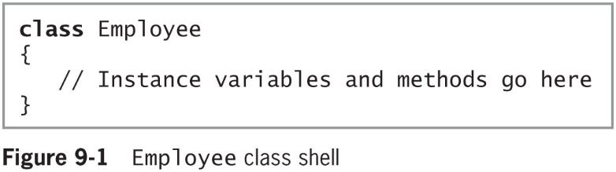
Creating a Class from Which Objects Can Be Instantiated (2 of 2)
© 2018 Cengage. May not be copied, scanned, or duplicated, in whole or in part, except for use as permitted in a license distributed with a certain product or service or otherwise on a password-protected website for classroom use.

Slide 9
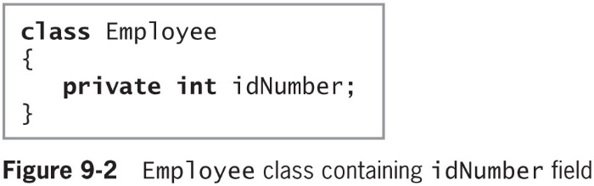
Creating Instance Variables and Methods (1 of 3)
When creating a class, define both its attributes and its methods
Field access modifiers
new, public, protected, internal, private, static, readonly, and volatile
Figure 9-2 shows an Employee class that contains the private idNumber field
© 2018 Cengage. May not be copied, scanned, or duplicated, in whole or in part, except for use as permitted in a license distributed with a certain product or service or otherwise on a password-protected website for classroom use.

Slide 10
Creating Instance Variables and Methods (2 of 3)
Most class fields are nonstatic and private
Using private fields within classes is an example of information hiding
Most class methods are public
private data/public method arrangement
Allows you to control outside access to your data
Composition
Using an object within another object
Defines a has-a relationship
© 2018 Cengage. May not be copied, scanned, or duplicated, in whole or in part, except for use as permitted in a license distributed with a certain product or service or otherwise on a password-protected website for classroom use.

Slide 11
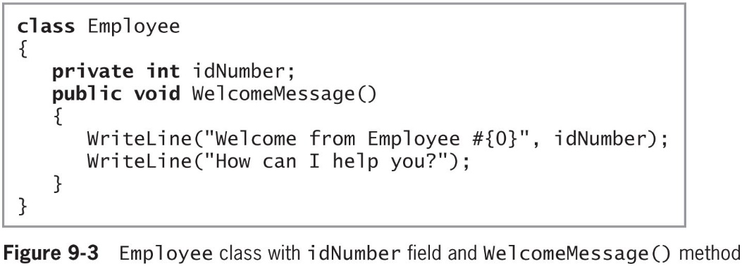
Creating Instance Variables and Methods (3 of 3)
Figure 9-3 shows the Employee class with the addition of the WelcomeMessage() method
© 2018 Cengage. May not be copied, scanned, or duplicated, in whole or in part, except for use as permitted in a license distributed with a certain product or service or otherwise on a password-protected website for classroom use.

Slide 12
Creating Objects (1 of 3)
Declaring a class does not create any actual objects
The two-step process to create an object:
Declare a reference to the object
Create the object using the new keyword, which allocates memory for it
Employee myAssistant;
myAssistant = new Employee();
-or-
Employee myAssistant = new Employee();
When you create an object, you call its constructor
© 2018 Cengage. May not be copied, scanned, or duplicated, in whole or in part, except for use as permitted in a license distributed with a certain product or service or otherwise on a password-protected website for classroom use.

Slide 13
Creating Objects (2 of 3)
Because identifiers for objects are references to their memory addresses, you can call any class a reference type
A type that refers to a specific memory location
Value types hold values as opposed to memory addresses
Examples: int, double, and char
Invoking object
An object that uses an instance method
© 2018 Cengage. May not be copied, scanned, or duplicated, in whole or in part, except for use as permitted in a license distributed with a certain product or service or otherwise on a password-protected website for classroom use.

Slide 14
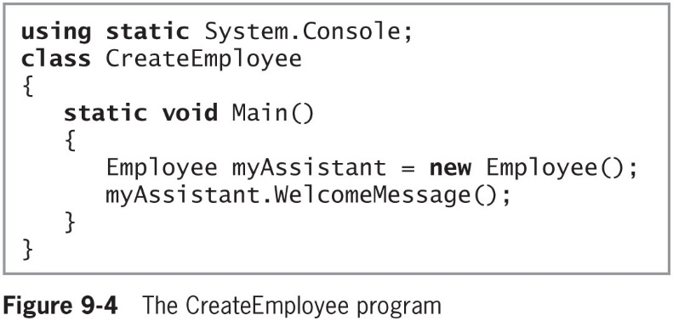
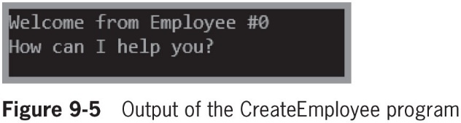
Creating Objects (3 of 3)
© 2018 Cengage. May not be copied, scanned, or duplicated, in whole or in part, except for use as permitted in a license distributed with a certain product or service or otherwise on a password-protected website for classroom use.

Slide 15
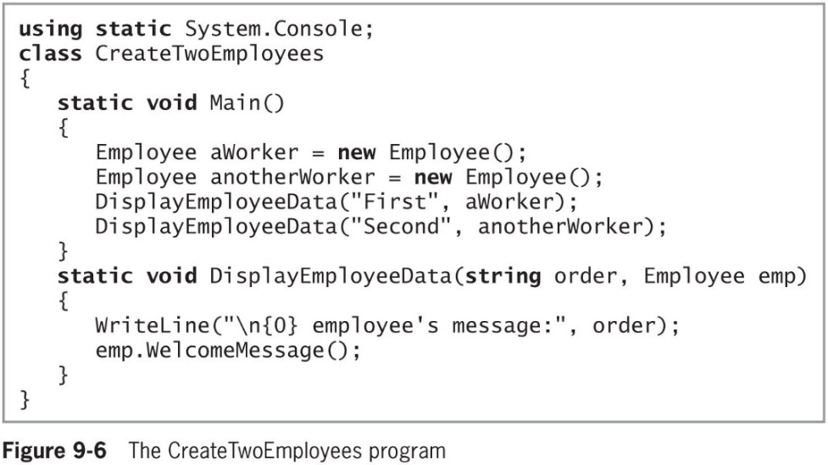
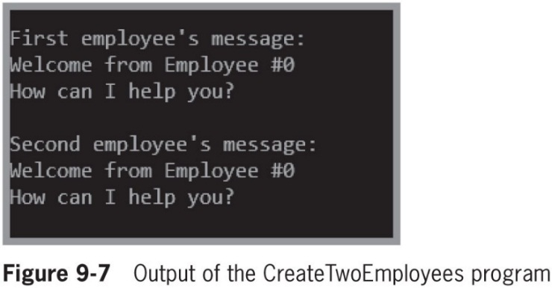
Passing Objects to Methods
You can pass objects to methods just as you can pass variables that are simple data types
© 2018 Cengage. May not be copied, scanned, or duplicated, in whole or in part, except for use as permitted in a license distributed with a certain product or service or otherwise on a password-protected website for classroom use.

Slide 16
Creating Properties (1 of 4)
Property
A member of a class that provides access to a field of a class
Defines how fields will be set and retrieved
Properties have accessors
set accessors for setting an object’s fields – called setter
get accessors for retrieving the stored values – called getter
Readonly property
Has only a get accessor
© 2018 Cengage. May not be copied, scanned, or duplicated, in whole or in part, except for use as permitted in a license distributed with a certain product or service or otherwise on a password-protected website for classroom use.

Slide 17
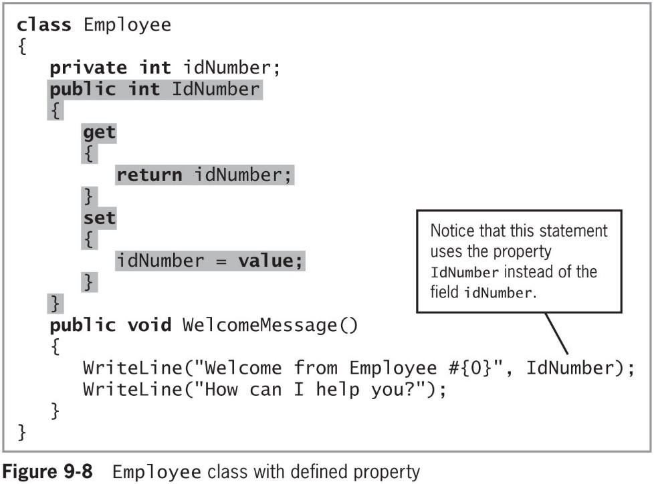
Creating Properties (2 of 4)
© 2018 Cengage. May not be copied, scanned, or duplicated, in whole or in part, except for use as permitted in a license distributed with a certain product or service or otherwise on a password-protected website for classroom use.

Slide 18
Creating Properties (3 of 4)
Contextual keywords
Identifiers that act like keywords in specific circumstances
Add, sync, await, dynamic, get, global, remove, set, value, partial, var, where, and yield
Implicit parameter
One that is undeclared and that gets its value automatically
© 2018 Cengage. May not be copied, scanned, or duplicated, in whole or in part, except for use as permitted in a license distributed with a certain product or service or otherwise on a password-protected website for classroom use.

Slide 19
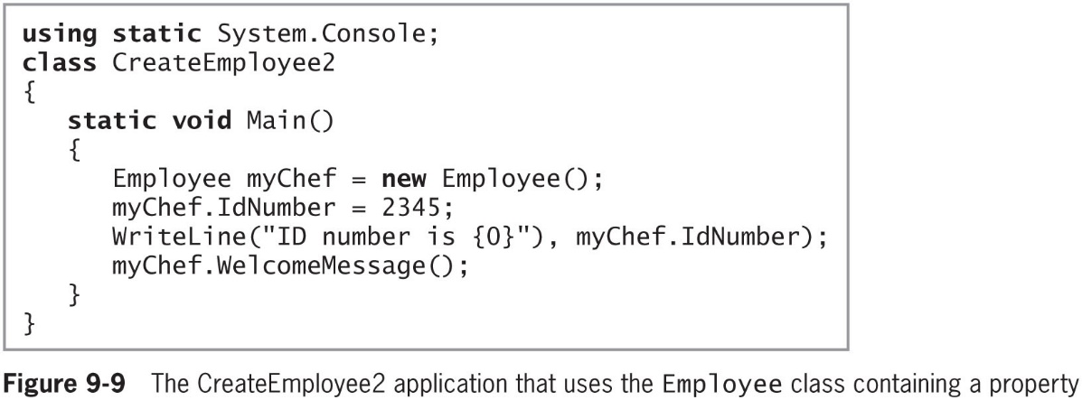
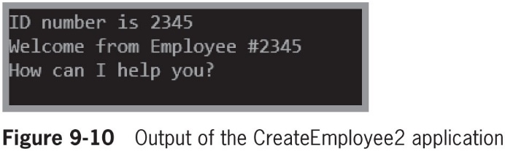
Creating Properties (4 of 4)
Figure 9-9 shows a complete application that uses the Employee class with accessors defined in Figure 9-8 and Figure 9-10 shows the output
© 2018 Cengage. May not be copied, scanned, or duplicated, in whole or in part, except for use as permitted in a license distributed with a certain product or service or otherwise on a password-protected website for classroom use.

Slide 20
Using Auto-Implemented Properties (1 of 2)
Auto-implemented property
Also called automatic properties
The property’s implementation is created for you automatically with the assumption that:
The set accessor should simply assign a value to the appropriate field
The get accessor should simply return the field
When you use an auto-implemented property, you do not need to declare the field that corresponds to the property
© 2018 Cengage. May not be copied, scanned, or duplicated, in whole or in part, except for use as permitted in a license distributed with a certain product or service or otherwise on a password-protected website for classroom use.

Slide 21
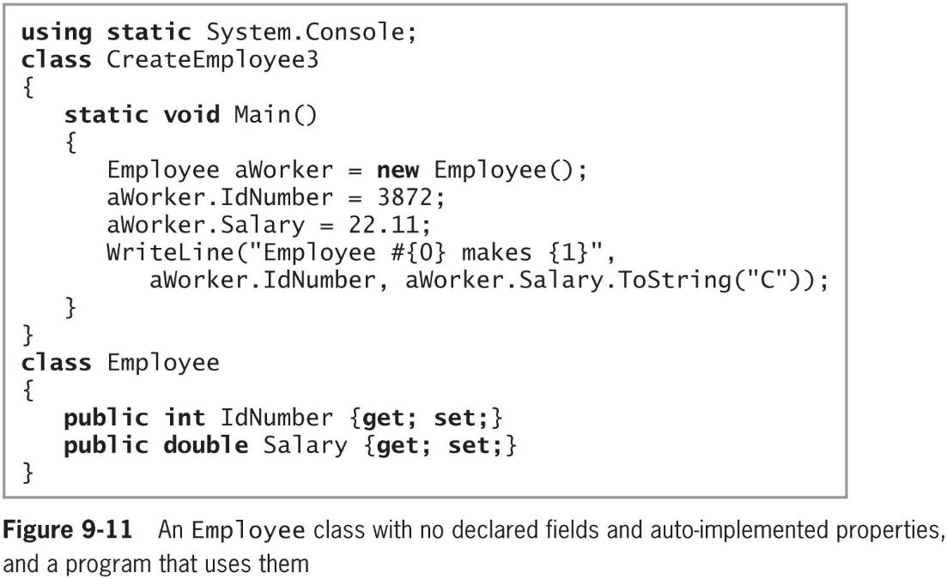
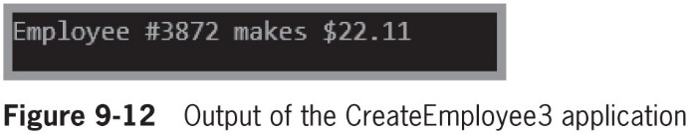
Using Auto-Implemented Properties (2 of 2)
© 2018 Cengage. May not be copied, scanned, or duplicated, in whole or in part, except for use as permitted in a license distributed with a certain product or service or otherwise on a password-protected website for classroom use.

Slide 22
More About public and private Access Modifiers (1 of 3)
Methods are usually declared as public
Fields are usually declared as private
Data should be hidden when at all possible, and access to it should be controlled by well-designed accessors
You can create a public data field when you want all objects of a class to contain the same value
A named constant within a class is always static
Belongs to the entire class, not to any particular instance
© 2018 Cengage. May not be copied, scanned, or duplicated, in whole or in part, except for use as permitted in a license distributed with a certain product or service or otherwise on a password-protected website for classroom use.

Slide 23
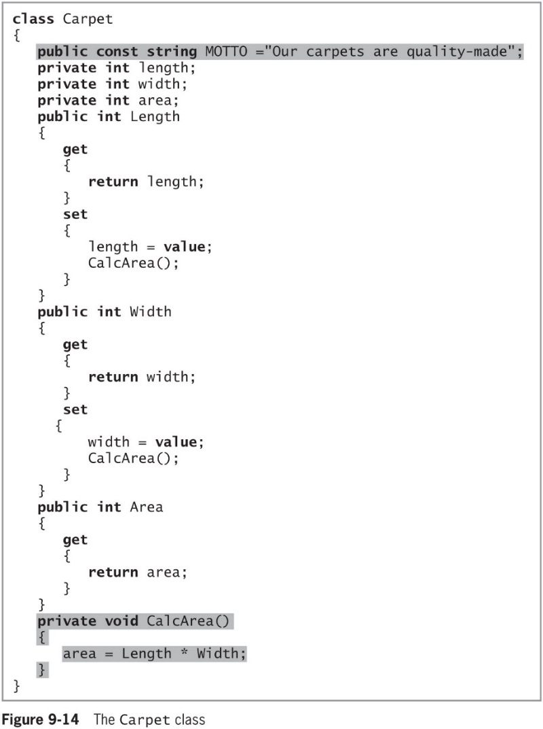
More About public and private Access Modifiers (2 of 3)
© 2018 Cengage. May not be copied, scanned, or duplicated, in whole or in part, except for use as permitted in a license distributed with a certain product or service or otherwise on a password-protected website for classroom use.

Slide 24
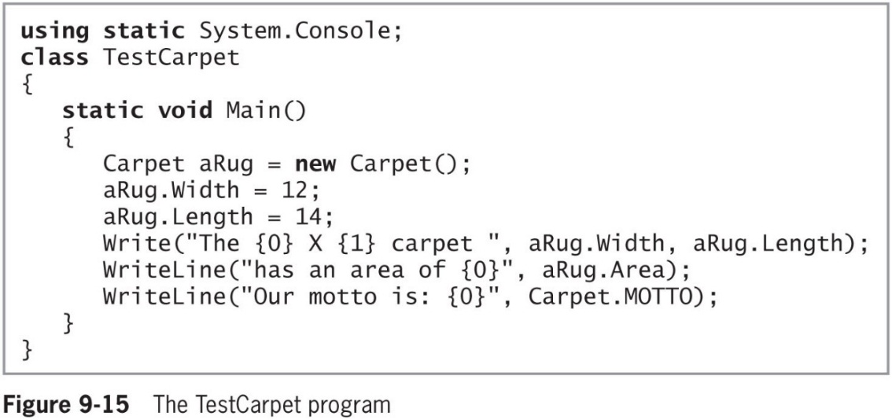
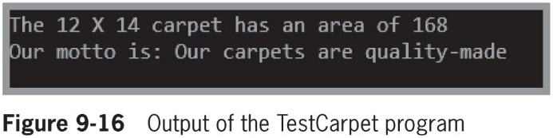
More About public and private Access Modifiers (3 of 3)
Figure 9-15 shows a program that instantiates and uses a Carpet object and Figure 9-16 shows the results when the program executes
© 2018 Cengage. May not be copied, scanned, or duplicated, in whole or in part, except for use as permitted in a license distributed with a certain product or service or otherwise on a password-protected website for classroom use.

Slide 25
Understanding the this Reference (1 of 5)
You might eventually create thousands of objects from a class
Each object does not need to store its own copy of each property and method
this reference
An implicitly passed reference
When you call a method, you automatically pass the this reference to the method
It tells the method which instance of the class to use
© 2018 Cengage. May not be copied, scanned, or duplicated, in whole or in part, except for use as permitted in a license distributed with a certain product or service or otherwise on a password-protected website for classroom use.

Slide 26
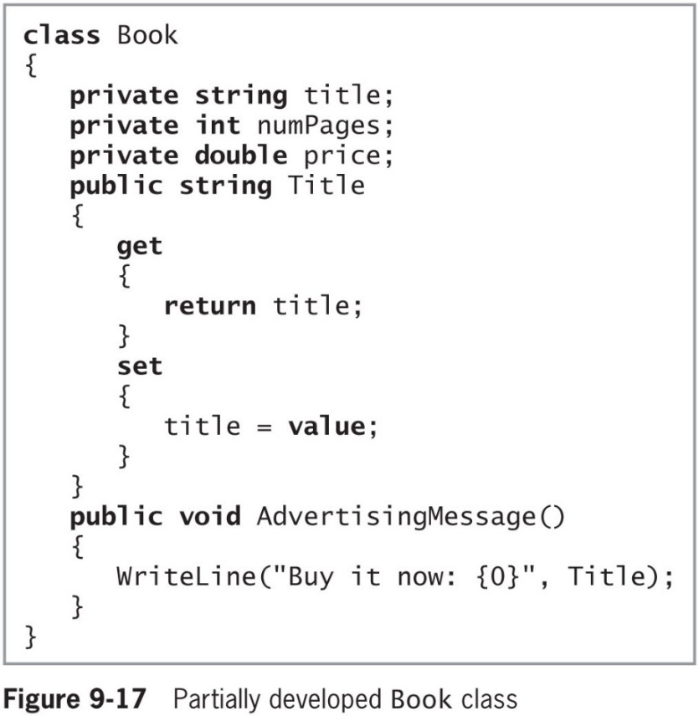
Understanding the this Reference (2 of 5)
Figure 9-17 shows part of a Book class that contains three fields
© 2018 Cengage. May not be copied, scanned, or duplicated, in whole or in part, except for use as permitted in a license distributed with a certain product or service or otherwise on a password-protected website for classroom use.

Slide 27
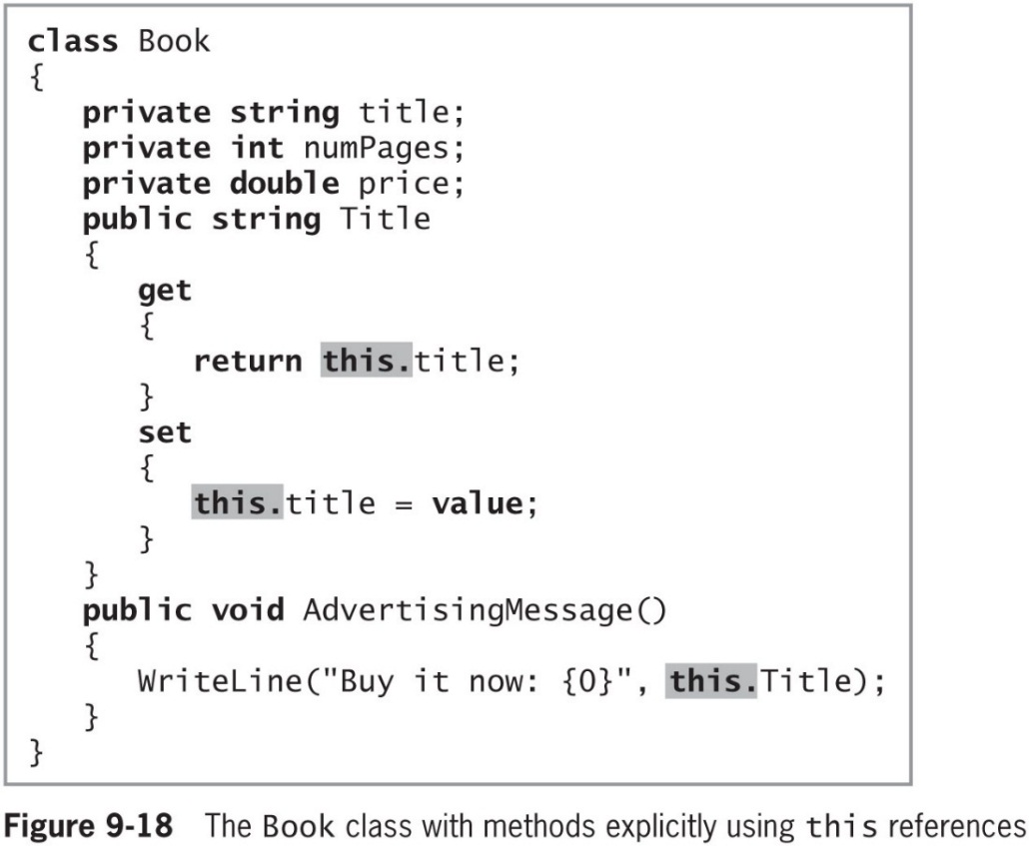
Understanding the this Reference (3 of 5)
Figure 9-18 shows the Book class with methods explicitly using this reference
© 2018 Cengage. May not be copied, scanned, or duplicated, in whole or in part, except for use as permitted in a license distributed with a certain product or service or otherwise on a password-protected website for classroom use.

Slide 28
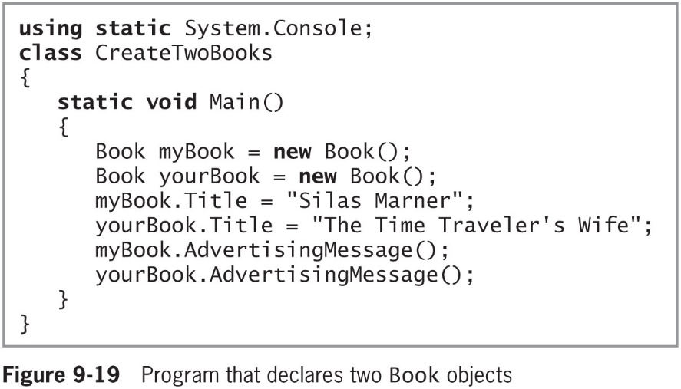
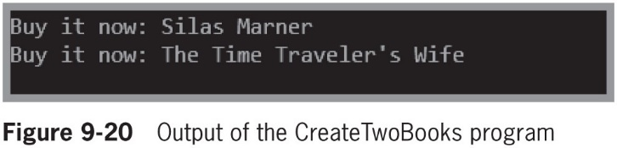
Understanding the this Reference (4 of 5)
Figure 9-19 shows an application that uses the Book class and Figure 9-20 shows the output
© 2018 Cengage. May not be copied, scanned, or duplicated, in whole or in part, except for use as permitted in a license distributed with a certain product or service or otherwise on a password-protected website for classroom use.

Slide 29
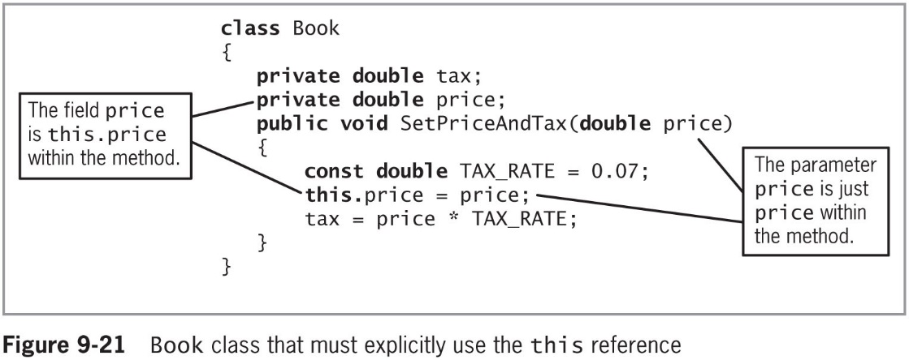
Understanding the this Reference (5 of 5)
© 2018 Cengage. May not be copied, scanned, or duplicated, in whole or in part, except for use as permitted in a license distributed with a certain product or service or otherwise on a password-protected website for classroom use.

Slide 30
Understanding Constructors
Constructor
A method that instantiates an object
Default constructor
An automatically supplied constructor without parameters
Default value of the object
The value of an object initialized with a default constructor
© 2018 Cengage. May not be copied, scanned, or duplicated, in whole or in part, except for use as permitted in a license distributed with a certain product or service or otherwise on a password-protected website for classroom use.

Slide 31
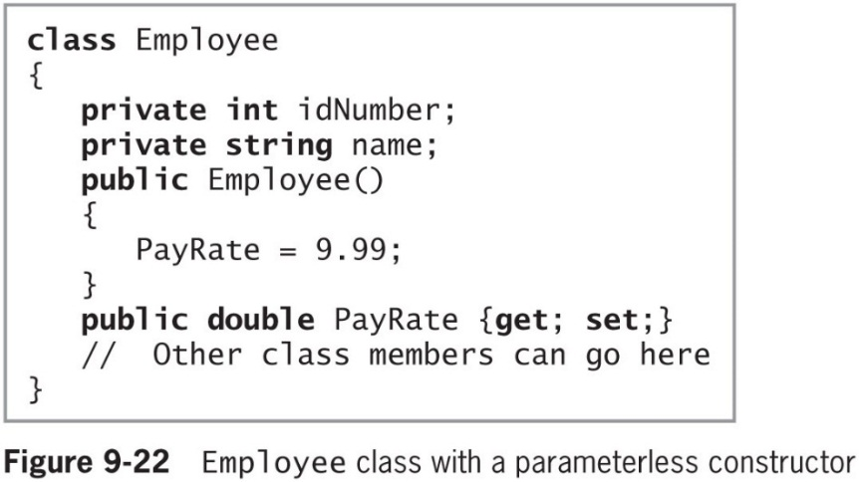
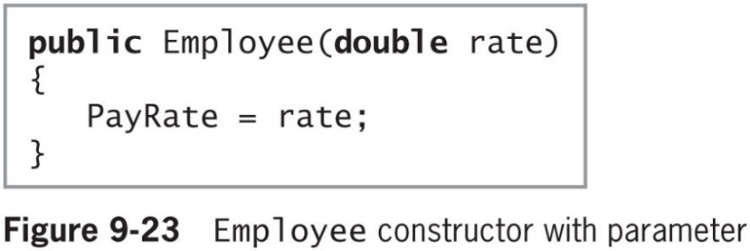
Passing Parameters to Constructors
Parameterless constructor
A constructor that takes no arguments
You can also create a constructor that receives argument(s)
© 2018 Cengage. May not be copied, scanned, or duplicated, in whole or in part, except for use as permitted in a license distributed with a certain product or service or otherwise on a password-protected website for classroom use.

Slide 32
Overloading Constructors (1 of 3)
C# automatically provides a default constructor until you provide your own constructor
Constructors can be overloaded
You can write as many constructors as you want, as long as their argument lists do not cause ambiguity
A class can contain only one parameterless constructor: the default constructor
Which can be the automatically-provided one or one that you write
© 2018 Cengage. May not be copied, scanned, or duplicated, in whole or in part, except for use as permitted in a license distributed with a certain product or service or otherwise on a password-protected website for classroom use.

Slide 33
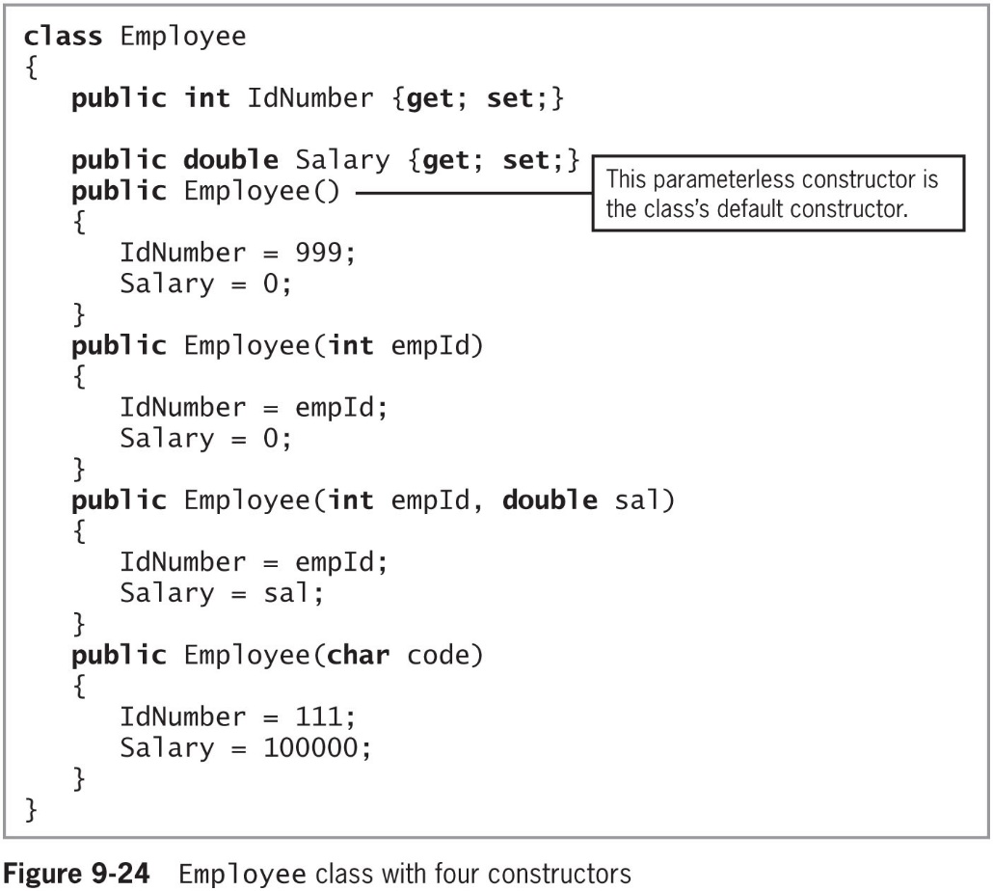
Overloading Constructors (2 of 3)
© 2018 Cengage. May not be copied, scanned, or duplicated, in whole or in part, except for use as permitted in a license distributed with a certain product or service or otherwise on a password-protected website for classroom use.

Slide 34
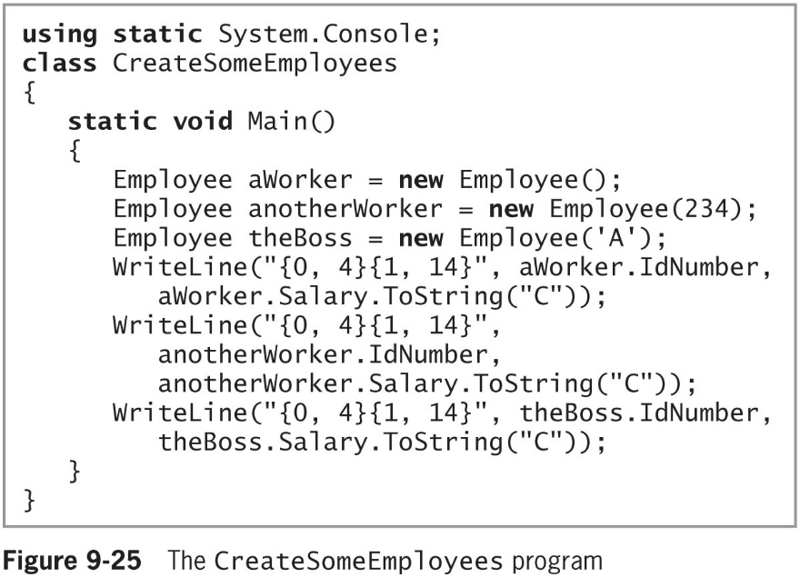
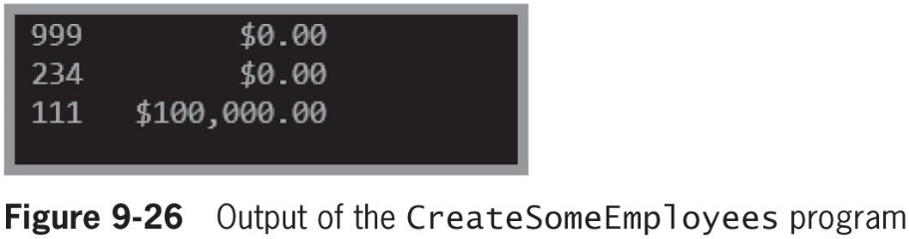
Overloading Constructors (3 of 3)
© 2018 Cengage. May not be copied, scanned, or duplicated, in whole or in part, except for use as permitted in a license distributed with a certain product or service or otherwise on a password-protected website for classroom use.

Slide 35
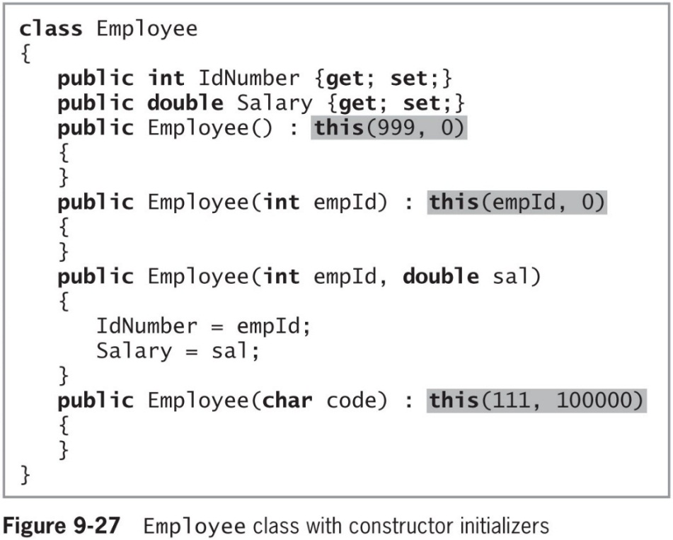
Using Constructor Initializers
Constructor initializer
A clause that indicates another instance of a class constructor should be executed before any statements in the current constructor body
© 2018 Cengage. May not be copied, scanned, or duplicated, in whole or in part, except for use as permitted in a license distributed with a certain product or service or otherwise on a password-protected website for classroom use.

Slide 36
Using the readonly Modifier in a Constructor (1 of 2)
readonly modifiers are similar to const
They are assigned a value that cannot be changed
Their value can be assigned at run time rather than at compile time
They can get their value from user input or the operating system
© 2018 Cengage. May not be copied, scanned, or duplicated, in whole or in part, except for use as permitted in a license distributed with a certain product or service or otherwise on a password-protected website for classroom use.

Slide 37
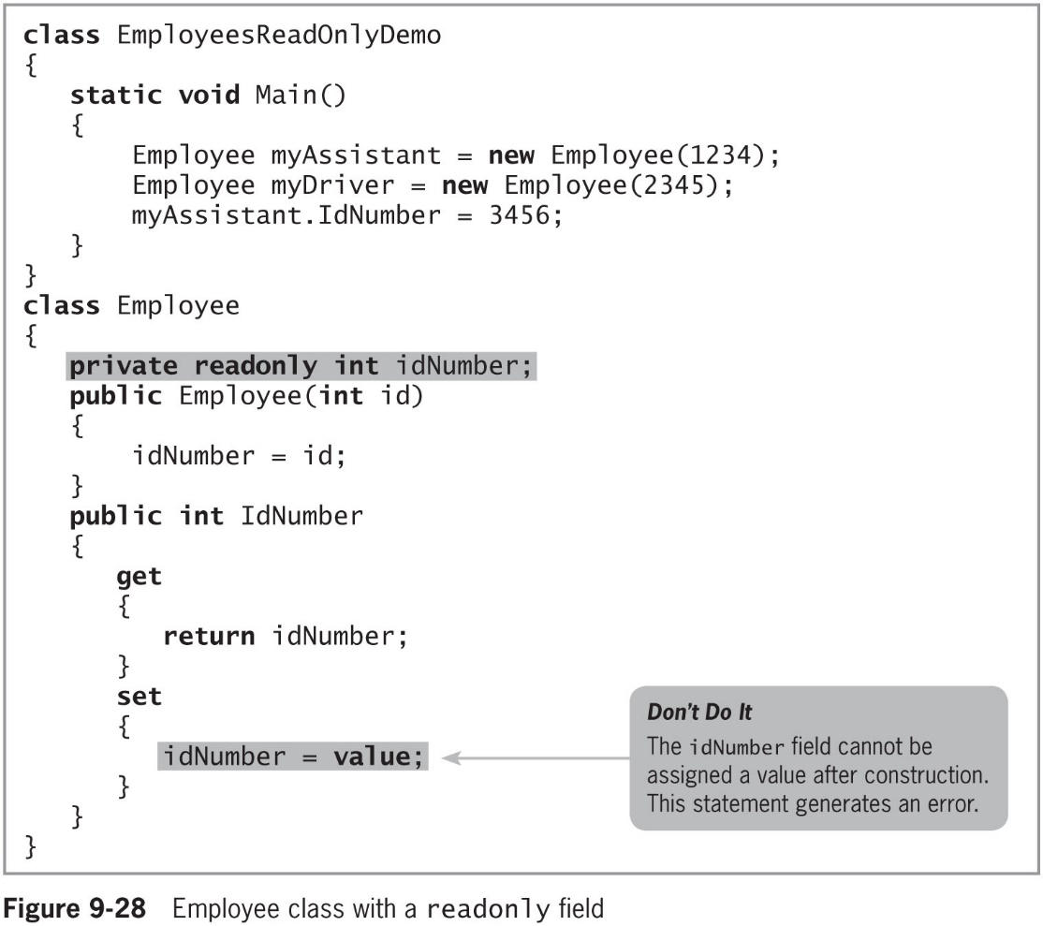
Using the readonly Modifier in a Constructor (2 of 2)
© 2018 Cengage. May not be copied, scanned, or duplicated, in whole or in part, except for use as permitted in a license distributed with a certain product or service or otherwise on a password-protected website for classroom use.

Slide 38
Using Object Initializers (1 of 4)
Object initializer
Allows you to assign values to any accessible members or properties of a class at the time of instantiation without calling a constructor with parameters
You can write an object initializer in either of the following ways:
Employee aWorker = new Employee{IdNumber = 101};
Employee aWorker = new Employee(){IdNumber = 101};
© 2018 Cengage. May not be copied, scanned, or duplicated, in whole or in part, except for use as permitted in a license distributed with a certain product or service or otherwise on a password-protected website for classroom use.

Slide 39
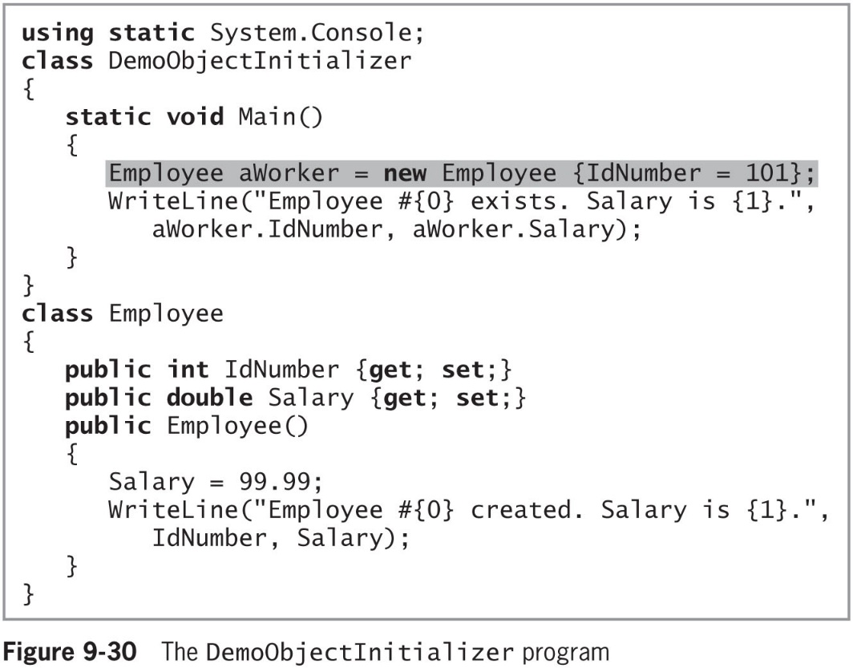
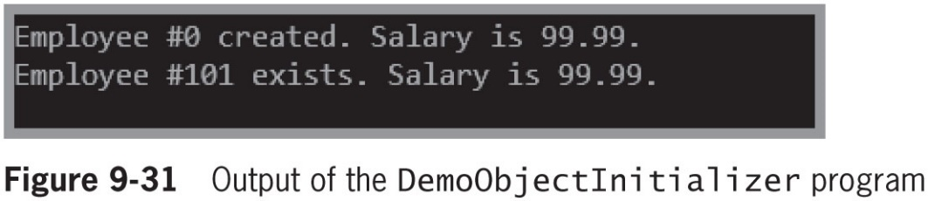
Using Object Initializers (2 of 4)
© 2018 Cengage. May not be copied, scanned, or duplicated, in whole or in part, except for use as permitted in a license distributed with a certain product or service or otherwise on a password-protected website for classroom use.

Slide 40
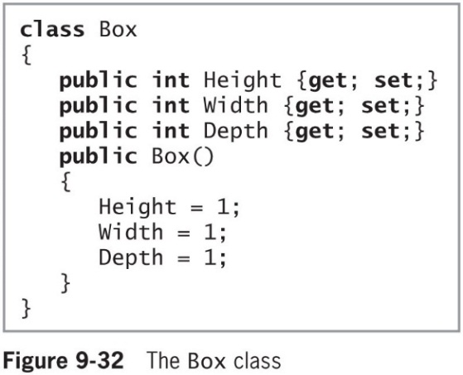
Using Object Initializers (3 of 4)
Using object initializers allows you to:
Create multiple objects with different initial assignments without having to provide multiple constructors to cover every possible situation
Create objects with different starting values for different properties of the same data type
The Box class (right) contains multiple properties of the same type -- The constructor sets the Height, Width, and Depth properties to 1
© 2018 Cengage. May not be copied, scanned, or duplicated, in whole or in part, except for use as permitted in a license distributed with a certain product or service or otherwise on a password-protected website for classroom use.

Slide 41
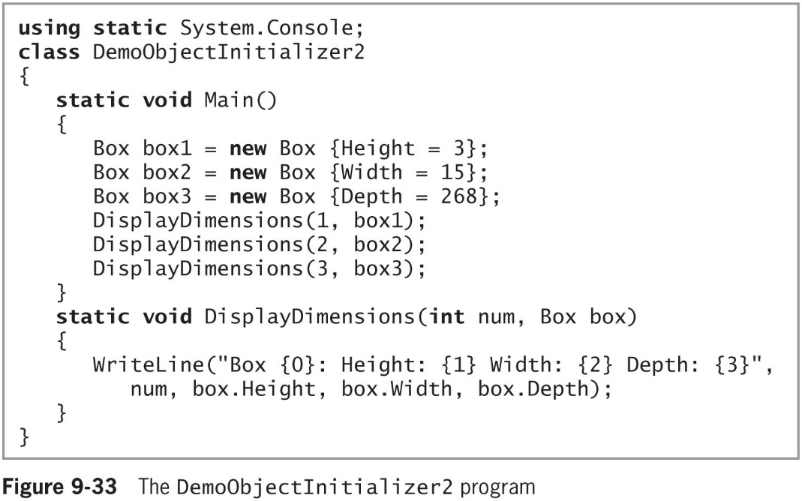
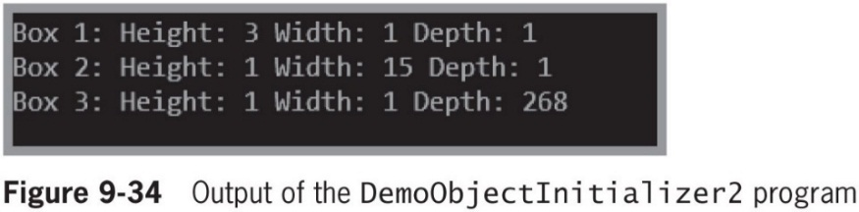
Using Object Initializers (4 of 4)
© 2018 Cengage. May not be copied, scanned, or duplicated, in whole or in part, except for use as permitted in a license distributed with a certain product or service or otherwise on a password-protected website for classroom use.

Slide 42
Overloading Operators (1 of 5)
Overloading operators
Enables you to use arithmetic symbols with your own objects
Overloadable unary operators:
+ − ! ~ ++ −− true false
Overloadable binary operators:
+ − * / % & | ^ == != > < >= <=
You cannot overload the following operators:
= && || ?? ?: checked unchecked new typeof as is
You cannot overload an operator for a built-in data type
© 2018 Cengage. May not be copied, scanned, or duplicated, in whole or in part, except for use as permitted in a license distributed with a certain product or service or otherwise on a password-protected website for classroom use.

Slide 43
Overloading Operators (2 of 5)
When a binary operator is overloaded and has a corresponding assignment operator, it is also overloaded
Some operators must be overloaded in pairs:
== with !=, and < with >
Syntax to overload unary operators:
type operator overloadable-operator (type identifier)
Syntax to overload binary operators:
type operator overloadable-operator (type identifier, type operand)
© 2018 Cengage. May not be copied, scanned, or duplicated, in whole or in part, except for use as permitted in a license distributed with a certain product or service or otherwise on a password-protected website for classroom use.

Slide 44
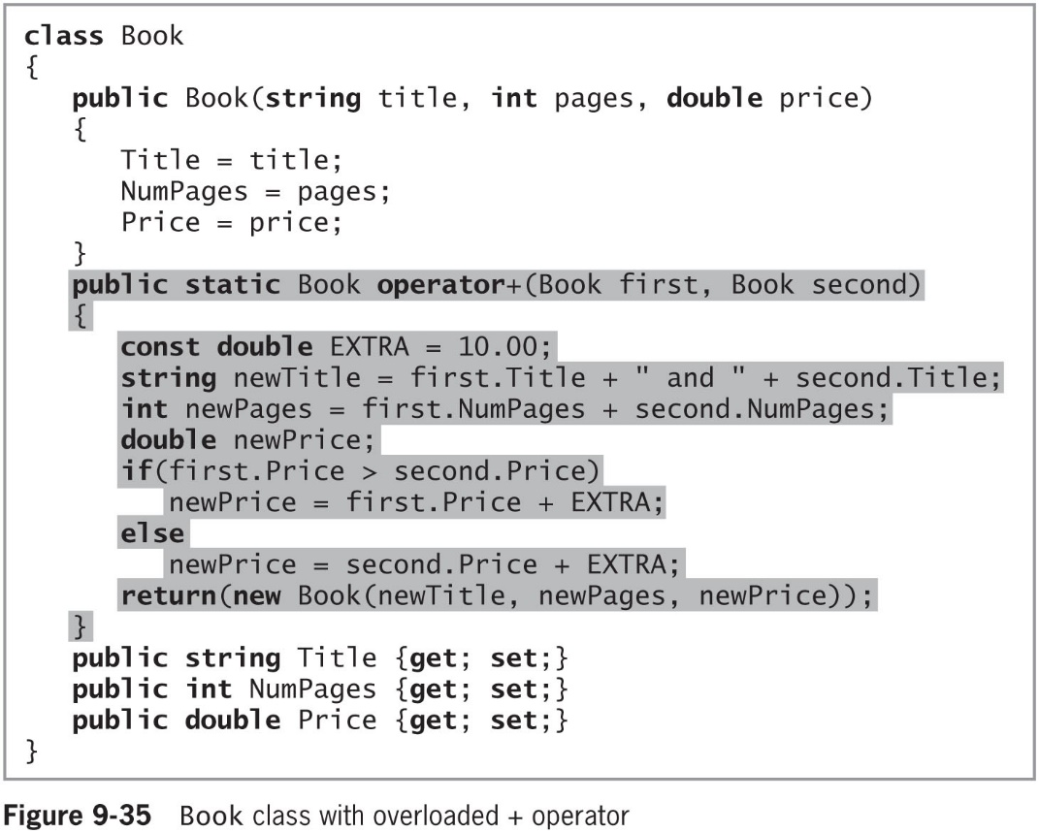
Overloading Operators (3 of 5)
© 2018 Cengage. May not be copied, scanned, or duplicated, in whole or in part, except for use as permitted in a license distributed with a certain product or service or otherwise on a password-protected website for classroom use.

Slide 45
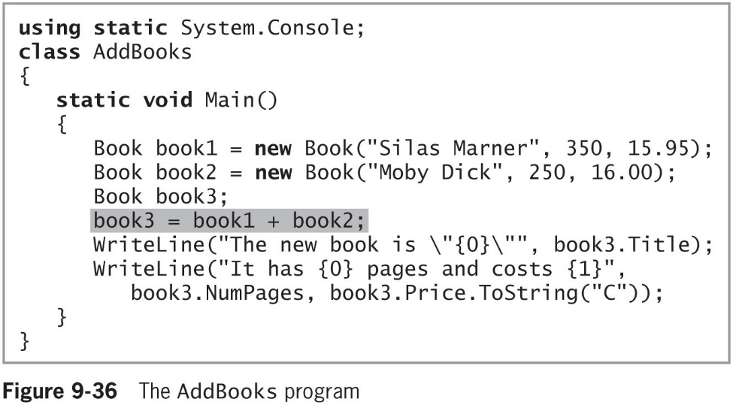
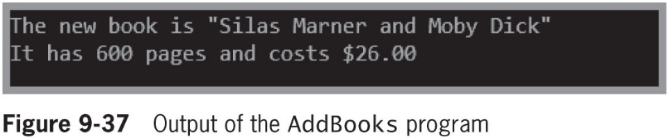
Overloading Operators (4 of 5)
© 2018 Cengage. May not be copied, scanned, or duplicated, in whole or in part, except for use as permitted in a license distributed with a certain product or service or otherwise on a password-protected website for classroom use.

Slide 46
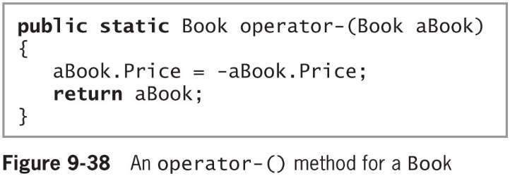
Overloading Operators (5 of 5)
Overloaded unary operators take a single argument
© 2018 Cengage. May not be copied, scanned, or duplicated, in whole or in part, except for use as permitted in a license distributed with a certain product or service or otherwise on a password-protected website for classroom use.

Slide 47
Declaring an Array of Objects
You can declare arrays that hold elements of any type, including objects
Example:
Employee[] empArray = new Employee[7];
for(int x = 0; x < empArray.Length; ++x)
empArray[x] = new Employee();
© 2018 Cengage. May not be copied, scanned, or duplicated, in whole or in part, except for use as permitted in a license distributed with a certain product or service or otherwise on a password-protected website for classroom use.

Slide 48
Using the Sort() and BinarySearch() Methods with Arrays of Objects (1 of 5)
The Sort() method accepts an array parameter and arranges its elements in descending order
The BinarySearch() method accepts a sorted array and a value that it attempts to match in the array
Interface
A collection of empty abstract methods that can be used by any class as long as the class provides a definition to override the interface’s do-nothing, or abstract, method definitions
An abstract method has no method statements
© 2018 Cengage. May not be copied, scanned, or duplicated, in whole or in part, except for use as permitted in a license distributed with a certain product or service or otherwise on a password-protected website for classroom use.

Slide 49
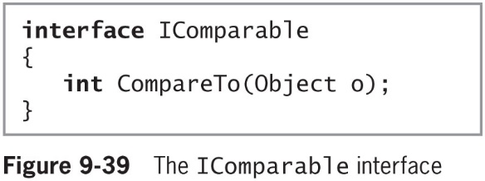
Using the Sort() and BinarySearch() Methods with Arrays of Objects (2 of 5)
When a method overrides another, it takes precedence, hiding the original version
IComparable interface
Contains the definition for the CompareTo() method
Compares one object to another and returns an integer
© 2018 Cengage. May not be copied, scanned, or duplicated, in whole or in part, except for use as permitted in a license distributed with a certain product or service or otherwise on a password-protected website for classroom use.

Slide 50
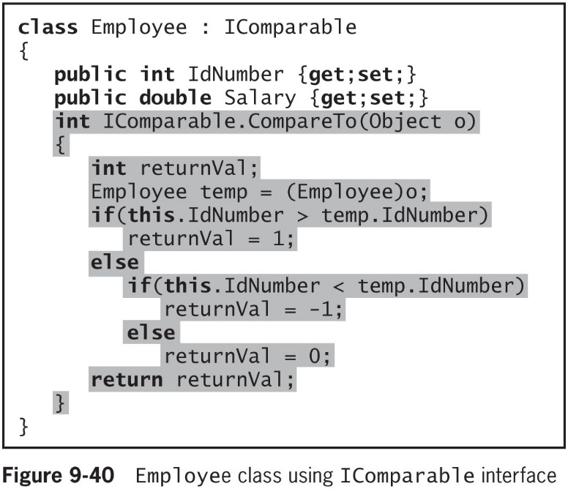
Using the Sort() and BinarySearch() Methods with Arrays of Objects (3 of 5)
© 2018 Cengage. May not be copied, scanned, or duplicated, in whole or in part, except for use as permitted in a license distributed with a certain product or service or otherwise on a password-protected website for classroom use.

Slide 51
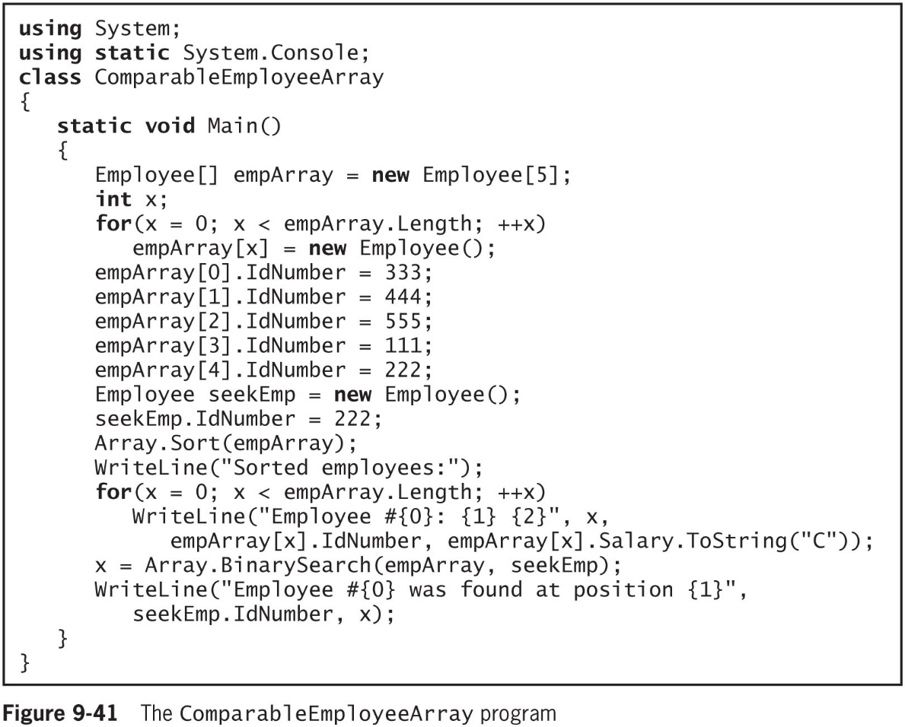
Using the Sort() and BinarySearch() Methods with Arrays of Objects (4 of 5)
© 2018 Cengage. May not be copied, scanned, or duplicated, in whole or in part, except for use as permitted in a license distributed with a certain product or service or otherwise on a password-protected website for classroom use.

Slide 52
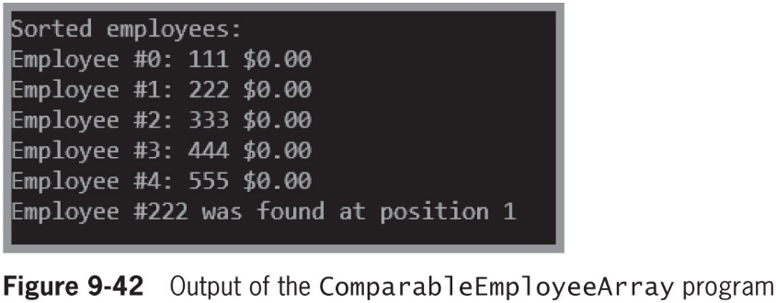
Using the Sort() and BinarySearch() Methods with Arrays of Objects (5 of 5)
© 2018 Cengage. May not be copied, scanned, or duplicated, in whole or in part, except for use as permitted in a license distributed with a certain product or service or otherwise on a password-protected website for classroom use.

Slide 53
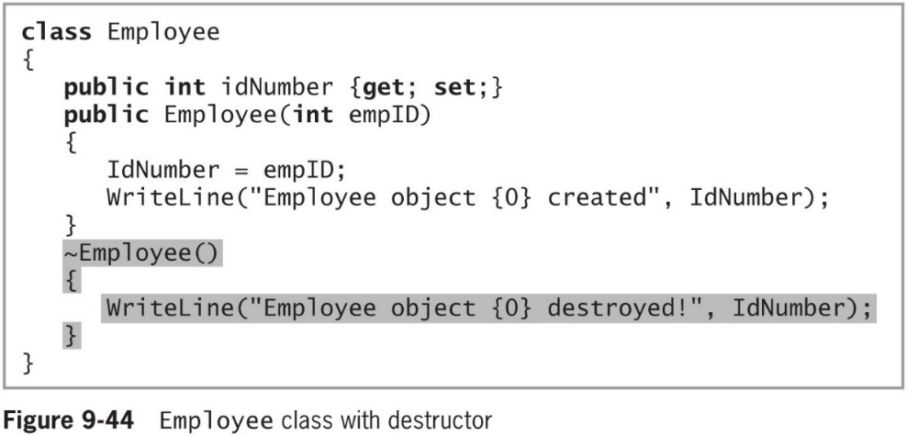
Understanding Destructors (1 of 2)
Destructor
Contains the actions you require when an instance of a class is destroyed
Most often, an instance of a class is destroyed when it goes out of scope
Explicitly declare a destructor
The identifier consists of a tilde (~) followed by the class name
© 2018 Cengage. May not be copied, scanned, or duplicated, in whole or in part, except for use as permitted in a license distributed with a certain product or service or otherwise on a password-protected website for classroom use.

Slide 54
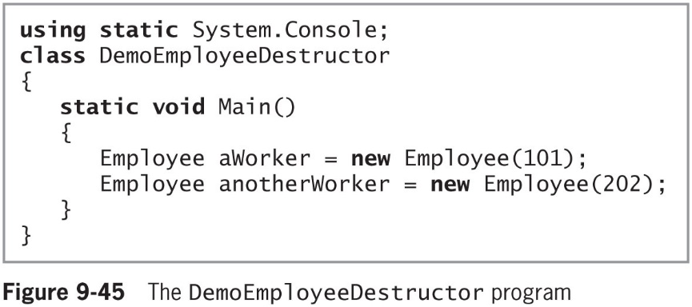
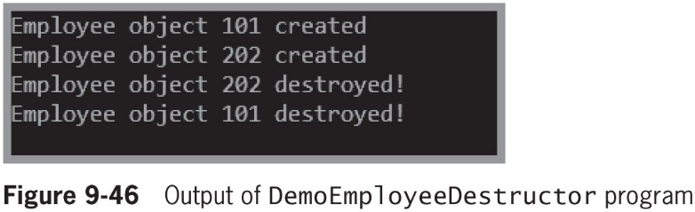
Understanding Destructors (2 of 2)
© 2018 Cengage. May not be copied, scanned, or duplicated, in whole or in part, except for use as permitted in a license distributed with a certain product or service or otherwise on a password-protected website for classroom use.

Slide 55
Understanding GUI Application Objects (1 of 3)
Objects you have been using in GUI applications are just like other objects
They encapsulate properties and methods
© 2018 Cengage. May not be copied, scanned, or duplicated, in whole or in part, except for use as permitted in a license distributed with a certain product or service or otherwise on a password-protected website for classroom use.

Slide 56
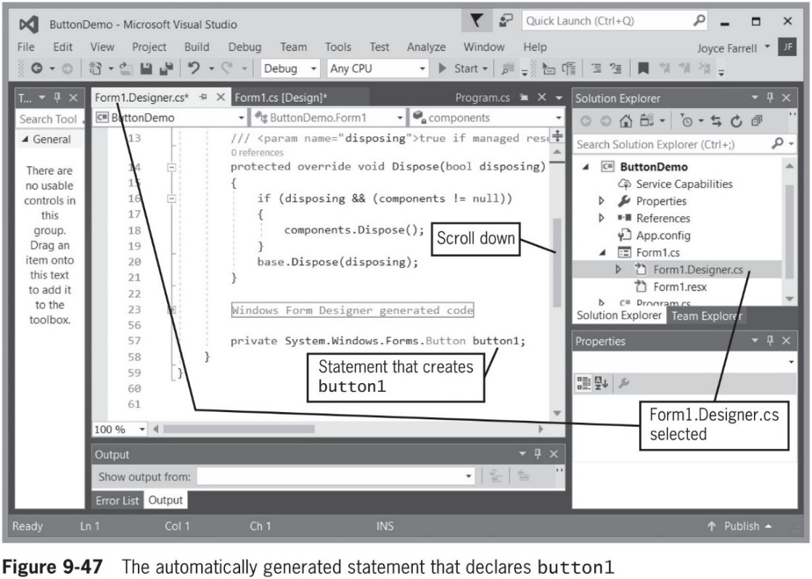
Understanding GUI Application Objects (2 of 3)
Figure 9-47 shows the code behind a new GUI application that a programmer started simply by dragging one Button onto a Form
© 2018 Cengage. May not be copied, scanned, or duplicated, in whole or in part, except for use as permitted in a license distributed with a certain product or service or otherwise on a password-protected website for classroom use.

Slide 57
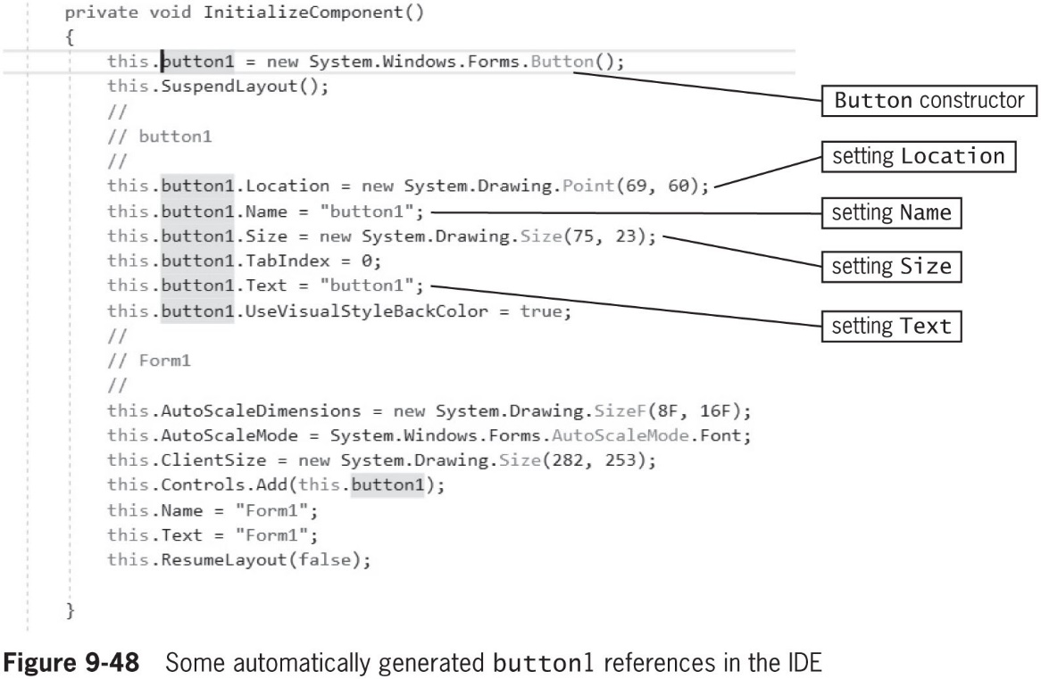
Understanding GUI Application Objects (3 of 3)
© 2018 Cengage. May not be copied, scanned, or duplicated, in whole or in part, except for use as permitted in a license distributed with a certain product or service or otherwise on a password-protected website for classroom use.

Slide 58
Chapter Summary (1 of 3)
You can create classes that are only programs with a Main() method, and classes from which you instantiate objects
When creating a class:
You must assign a name to it, and determine what data and methods will be part of the class
You usually declare instance variables to be private and instance methods to be public
When creating an object, supply a type and an identifier, and allocate computer memory for that object
A property is a member of a class that provides access to a field. Properties have set accessors for setting an object’s fields and get accessors for retrieving the stored values
© 2018 Cengage. May not be copied, scanned, or duplicated, in whole or in part, except for use as permitted in a license distributed with a certain product or service or otherwise on a password-protected website for classroom use.

Slide 59
Chapter Summary (2 of 3)
In most classes, fields are private and methods are public
The this reference is passed to every instance method and property accessor in a class
A constructor is a method that instantiates an object. With no constructor, each class is automatically supplied with a public constructor with no parameters
An object initializer allows you to assign values to any accessible members or properties of a class at the time of instantiation without calling a constructor with parameters
© 2018 Cengage. May not be copied, scanned, or duplicated, in whole or in part, except for use as permitted in a license distributed with a certain product or service or otherwise on a password-protected website for classroom use.

Slide 60
Chapter Summary (3 of 3)
You can overload an operator by writing a method whose identifier is operator, followed by the operator being overloaded—for example, operator+() or operator*()
You can declare arrays that hold elements of any type, including objects
A destructor contains the actions you require when an instance of a class is destroyed
GUI objects such as Forms, Buttons, and Labels are typical C# objects that encapsulate properties and methods
© 2018 Cengage. May not be copied, scanned, or duplicated, in whole or in part, except for use as permitted in a license distributed with a certain product or service or otherwise on a password-protected website for classroom use.

